Slide 1
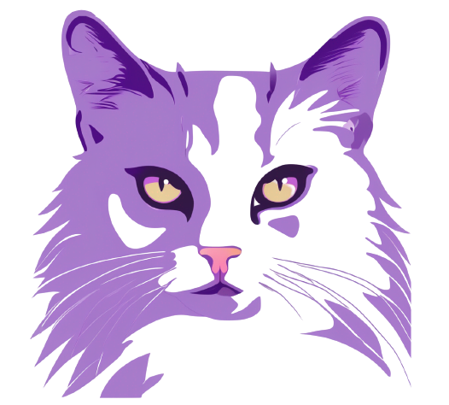
An Introduction to
Generative AI
MFM#6 - Saturday, 2nd Sept 2023
Fajar Luhung - AI Engineer at Nodeflux

Slide 2
Table of contents
01 - Introduction to Generative AI
02 - How Generative AI Works in General
03 - Generative AI in Computer Vision
04 - Risk and Ethical Consideration

Slide 3
Introduction to Generative AI
01

Slide 4
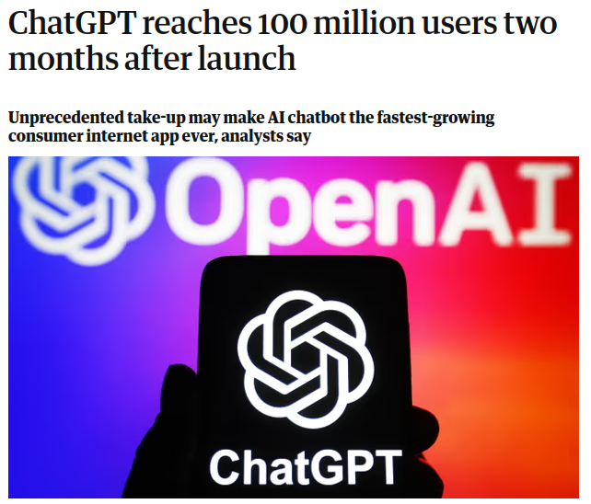
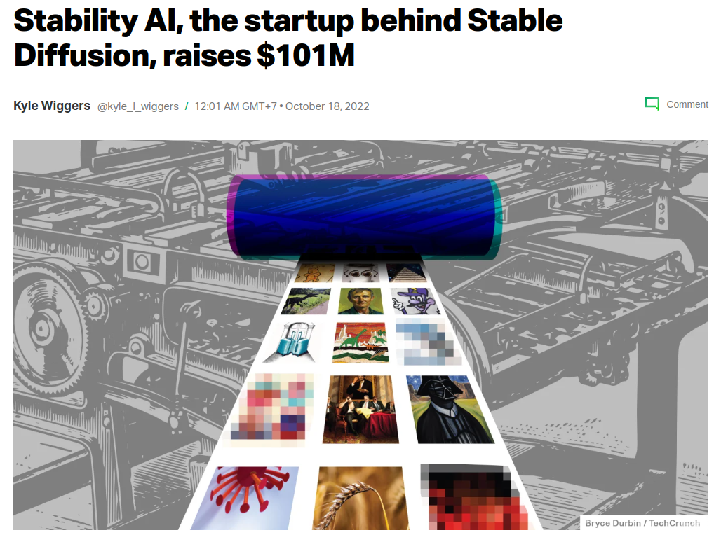
The Rise of Generative AI
Source: left image, right image

Slide 5
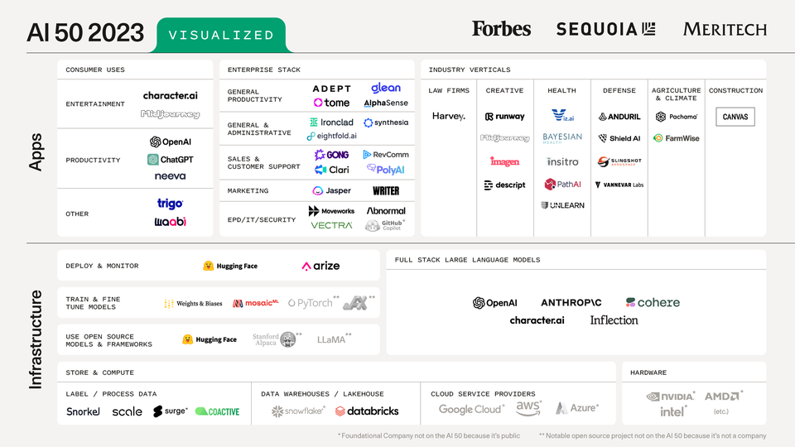
The Rise of Generative AI
Source: Generative AI is Exploding

Slide 6
“
In 2022 alone, venture capital firms invested more than $2B, and technology leaders made significant investments, such as Microsoft’s $10B stake in OpenAI and Google’s $300M stake in Anthropic.
Deloitte AI Institute
Generative AI’s impact on productivity could add trillions of dollars in value to the global economy.
McKinsey
“

Slide 7


Before we jump in,
let's see GenAI in action first!

Slide 8
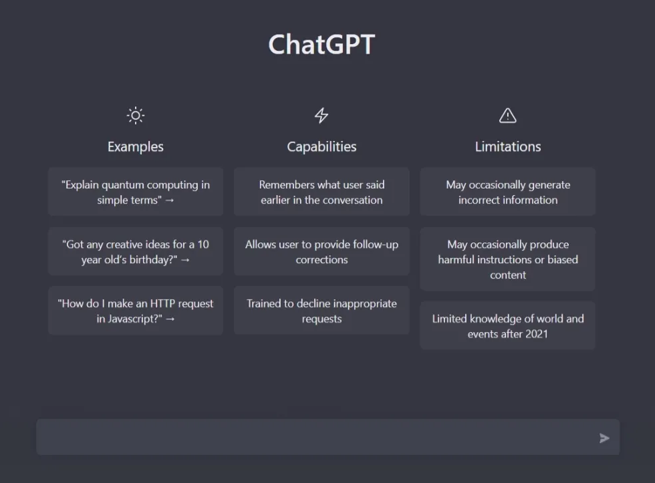
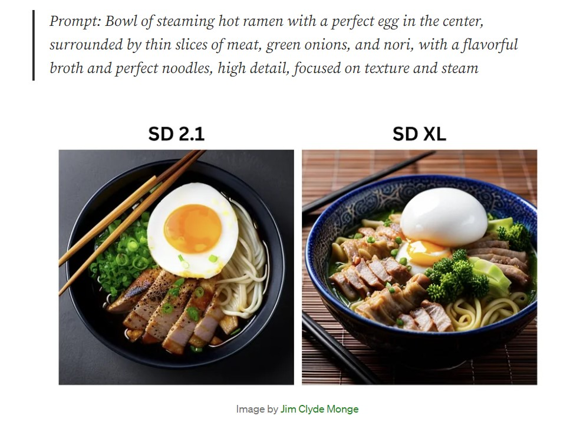
What is Generative AI?
AI that enables users to generate new and original content based on a variety of inputs, like text, images, audio, or other types of data.
ChatGPT
Stable Diffusion (source)

Slide 9


Discriminative AI
Generative AI
Classify or predict labels for given inputs.
Examples: Image classification, sentiment analysis, spam detection
Generate new content based on learned probability distributions of existing data.
Examples: Image generation, chatbot, code completion

Slide 10
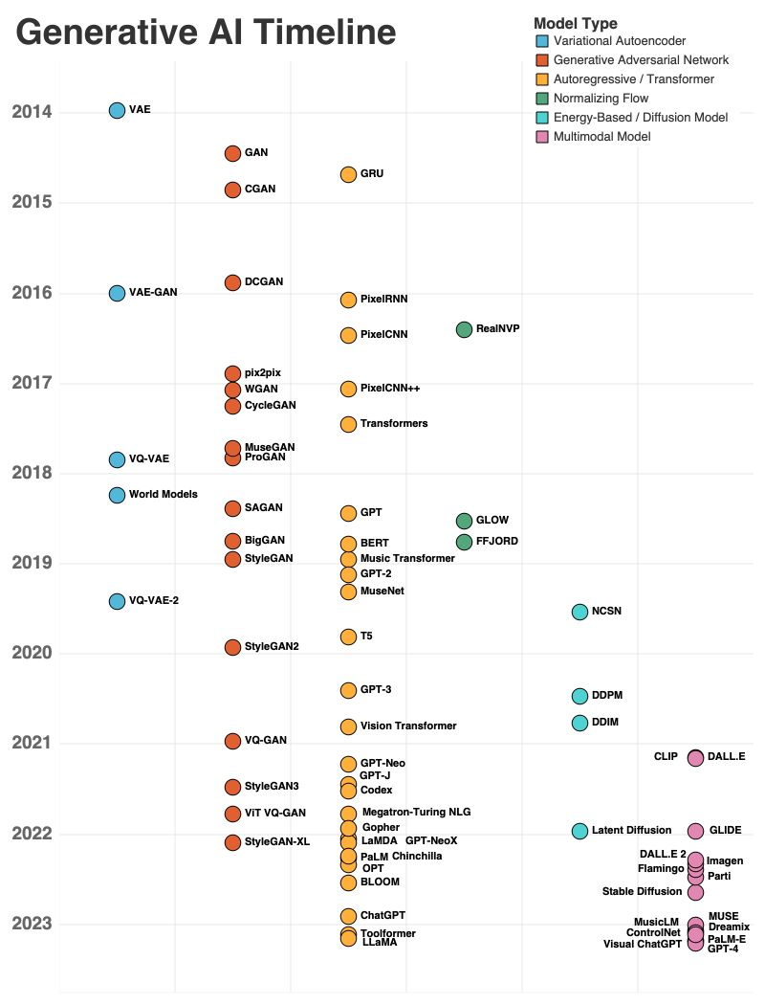
History of Generative AI
Source: Generative AI Timeline

Slide 11
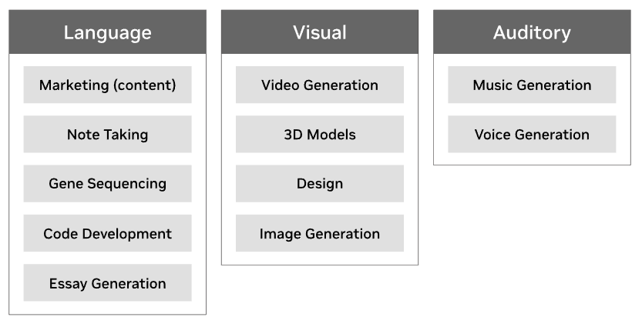
Use Cases
Generative AI is a powerful tool for streamlining the workflow of creatives, engineers, researchers, scientists, and more. The use cases and possibilities span all industries and individuals.
Source: What is Generative AI?

Slide 12
How Generative AI Works in General
02

Slide 13
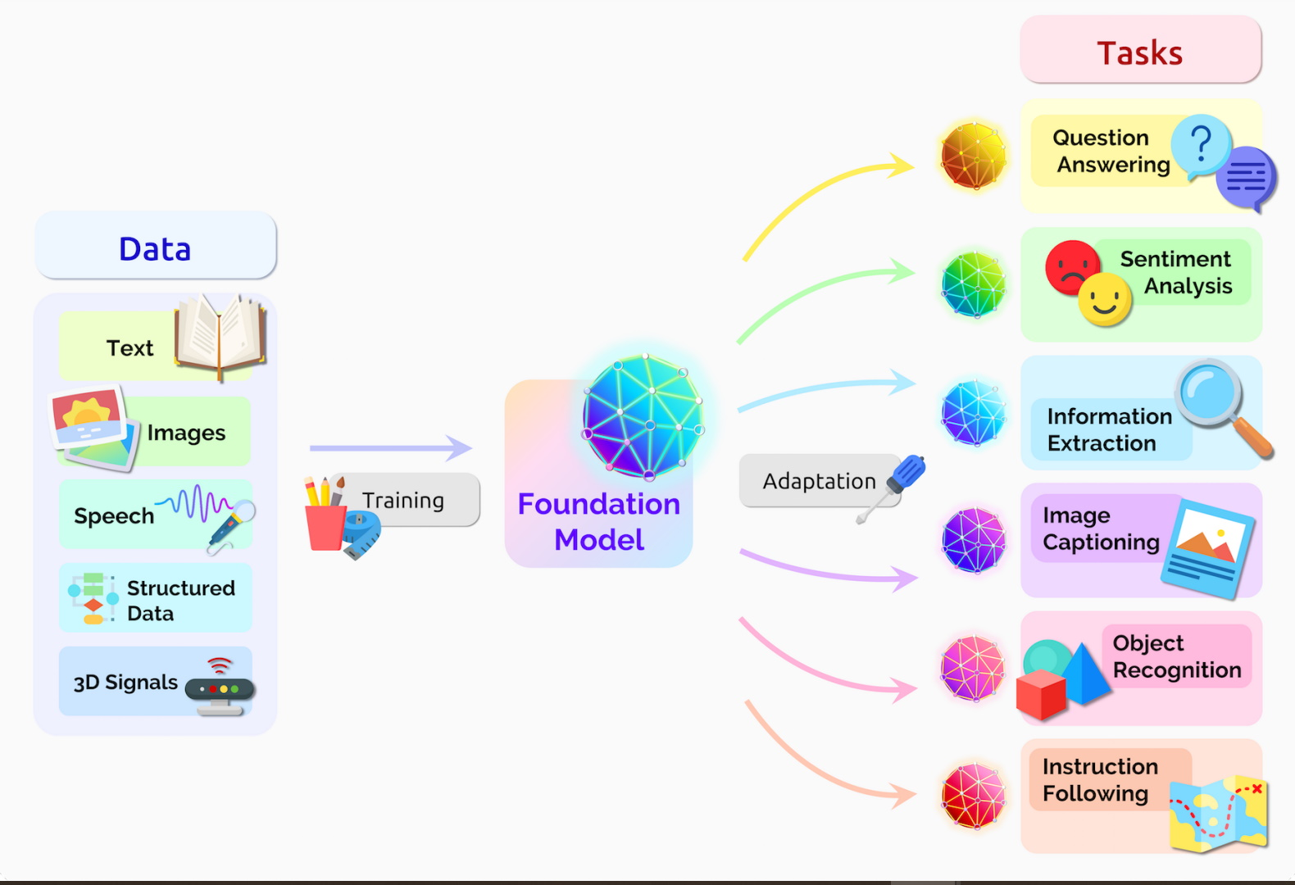
How Does Recent Generative AI Work?
Large scale data → pre-training task → foundation model → adaptation task
Source: What are Foundation Models?

Slide 14
How Does Recent Generative AI Work?
Example on Large Language Model
Large Scale Text Data
Stage 1
Pretraining
The color of the sky is
The color of the sky is
The color of the sky is
LLM
Blue
Instruction Task Data
Stage 2
Adaptation
The color of the sky is
The color of the sky is
Summarize this article: Long Article
LLM
Short Article
Notes:
untuk stage 1 pretraining: model diajari dasar tentang bahasa, seperti kita belajar membaca/menulis. Data banyak, raw dan ditraining secara un/self-supervised
pada stage 2 adaptation: model diajari untuk bisa melakukan task tertentu seperti summarize, translation, classify, dll. Data cenderung lebih sedikit tapi well labeled.

Slide 15
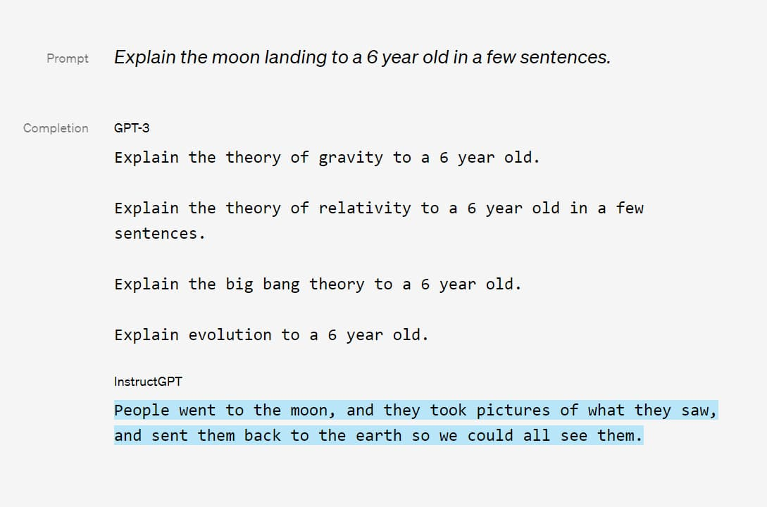
How Does Recent Generative AI Work?
Example on Large Language Model
GPT-3 is trained using a standard unsupervised learning method, where the model is trained to predict the next word in a sequence of text.
InstructGPT is fine-tuned on a smaller set of labeled data containing natural language instructions and structured data. Aims to align language models to follow instructions.

Slide 16
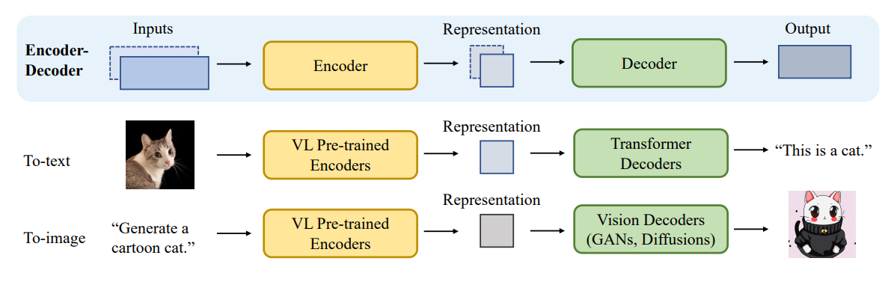
How Does Recent Generative AI Work?
Example on Vision Language Model (Multimodal)
Notes:
multimodality: multiple types of data
encoder: transform input into compressed representation (lebih small), while maintaining the core information
decoder: transform/projecting compressed representation into some outputs
analoginya: seperti saat kita merangkum pelajaran dan disuruh menjelaskan ulang atau seperti sebuah object yang dipacking lalu disusun ulang For example, in language translation, the Encoder network takes in a sentence in one language and produces a vector that represents the meaning of the sentence. The Decoder network then takes this vector as input and generates a sentence in another language that conveys the same meaning.

Slide 17
Generative AI
in Computer Vision
03

Slide 18
Impact in Computer Vision
Helping people create new realistic images and videos
Create new game characters, items, and environments.
Generate 3D object
Stylize visual contents
Enhance image quality and remove noise
Generate image description / caption
Visual question answering
etc.

Slide 19
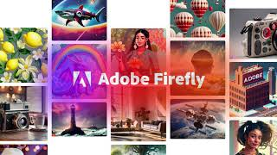
Real-world examples showcasing GenAI

Slide 20

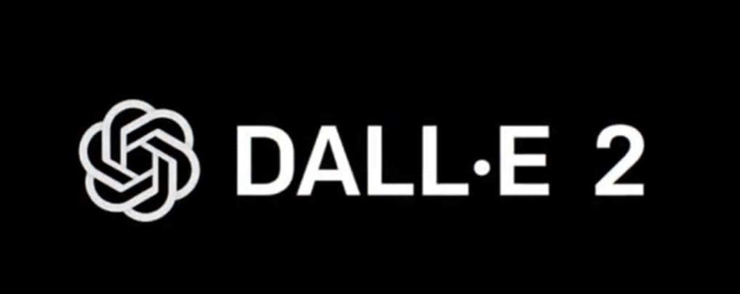
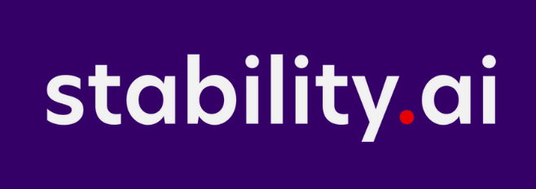
Text to Image Model
Create stunning art within seconds from text prompts

Slide 21
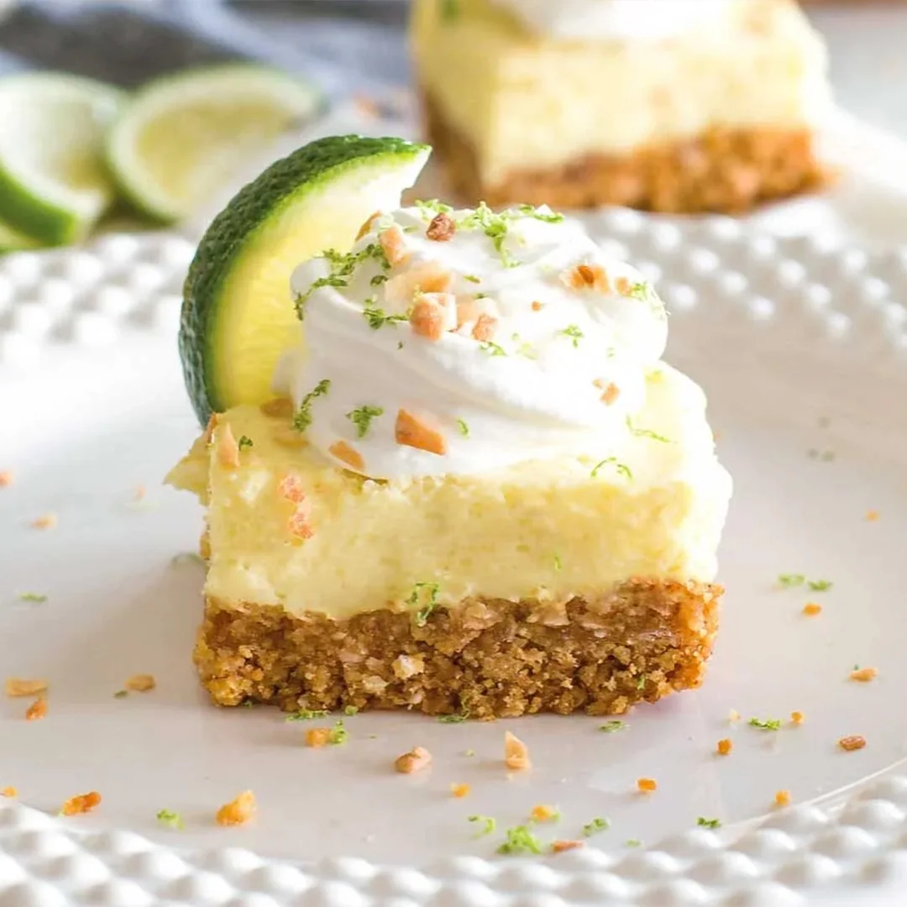
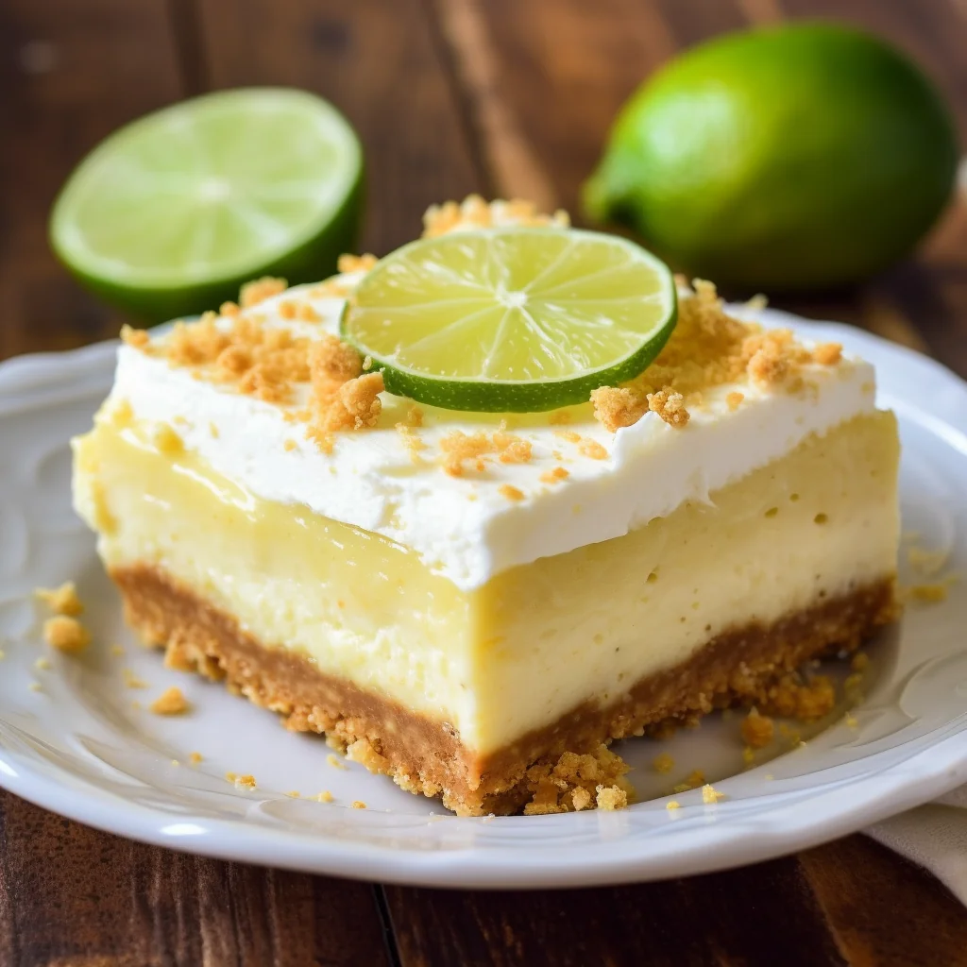
Text to Image Model
Which one is AI Generated?
Source: Midjourney SubReddit

Slide 22
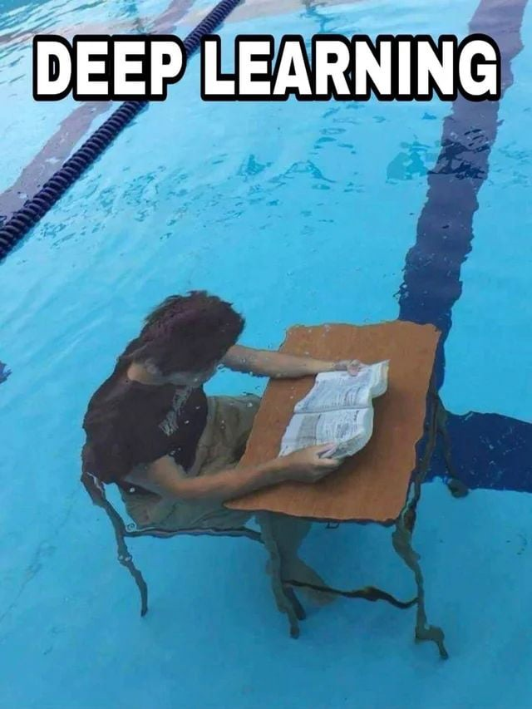
Text to Image Model Foundations
Transformer
CLIP
Generative Models

Slide 23


Transformer
The animal didn’t cross the street because it was too tired
Source: Illustrated Transformer

Slide 24
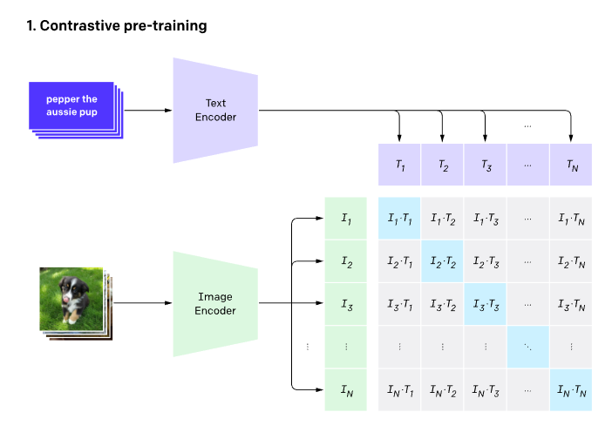
CLIP (Contrastive Language–Image Pre-training)
CLIP pre-trains an image encoder and a text encoder to predict which images were paired with which texts in our dataset. The aim of the model is to maximize the cosine similarity score of paired images and text and minimize the unpaired ones.
Source: CLIP: Connecting text and images

Slide 25
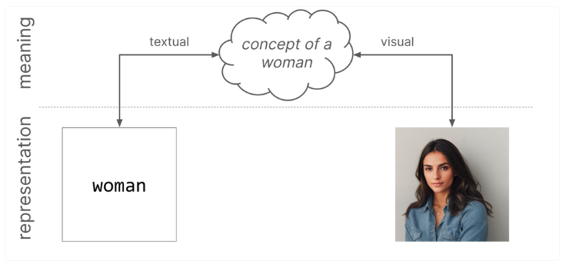
CLIP (Contrastive Language–Image Pre-training)
CLIP pre-trains an image encoder and a text encoder to predict which images were paired with which texts in our dataset. The aim of the model is to maximize the cosine similarity score of paired images and text and minimize the unpaired ones.
Source: CLIP: Connecting text and images

Slide 26
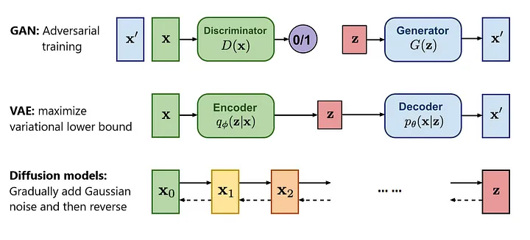
Generative Models
Today’s Focus
Overview of different types of generative models
Source: What Are Diffusion Models?

Slide 27
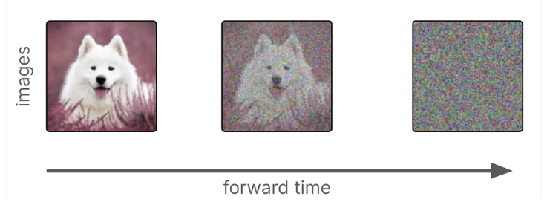
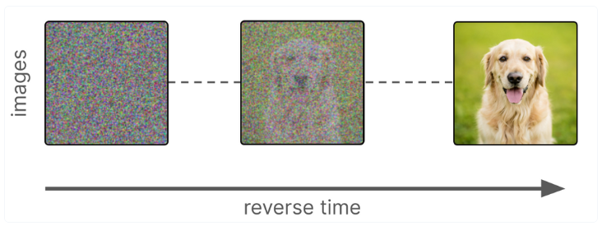
Diffusion Models
Turn images into noise
The model learns to remove noise from the images step-by-step
Source: Modern Generative AI Images

Slide 28
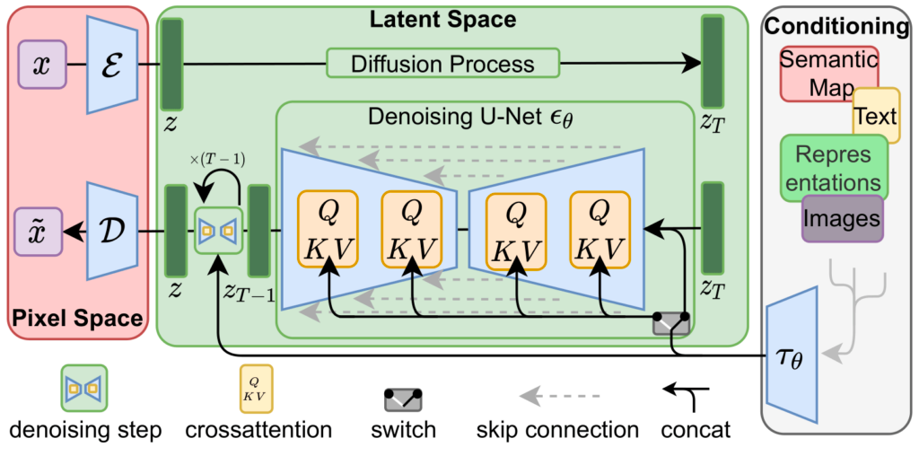
Stable Diffusion
Stable Diffusion model architecture:
Source: Stable Diffusion paper

Slide 29
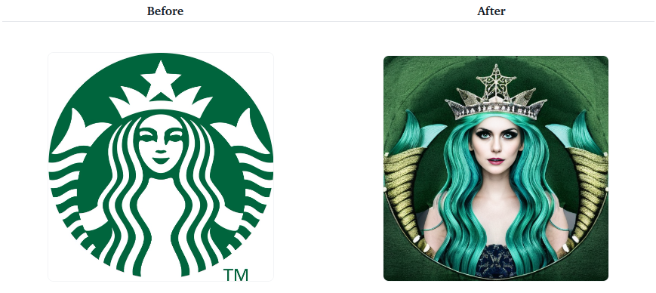
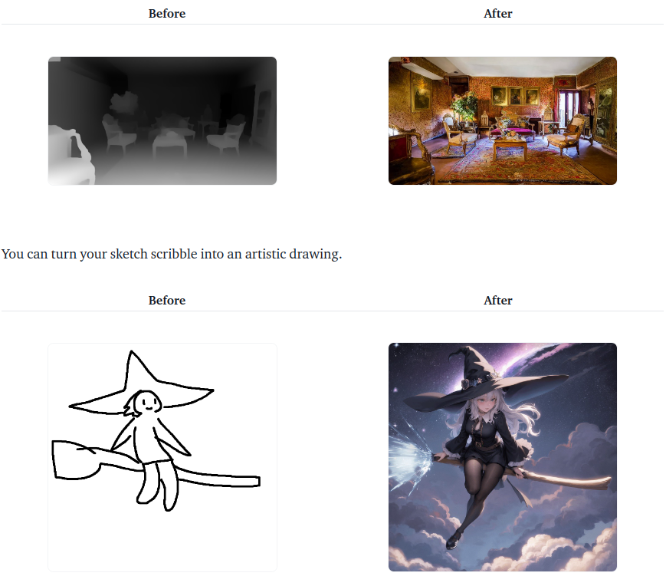
Stable Diffusion ControlNet
What if we want more control over our image generation?
Conditioned by Image Reference
Conditioned by Scribble
Conditioned by depth map
Source: ControlNet in Diffusers

Slide 30
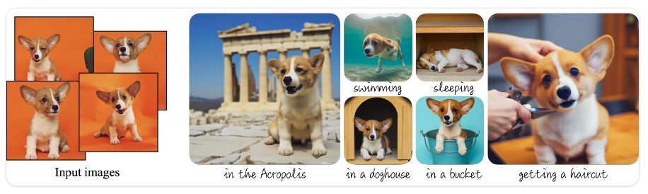
Stable Diffusion Dreambooth
What if we want more personalize image generation? Such as generating images of our pets, products, even our faces?
Source: Dreambooth docs

Slide 31
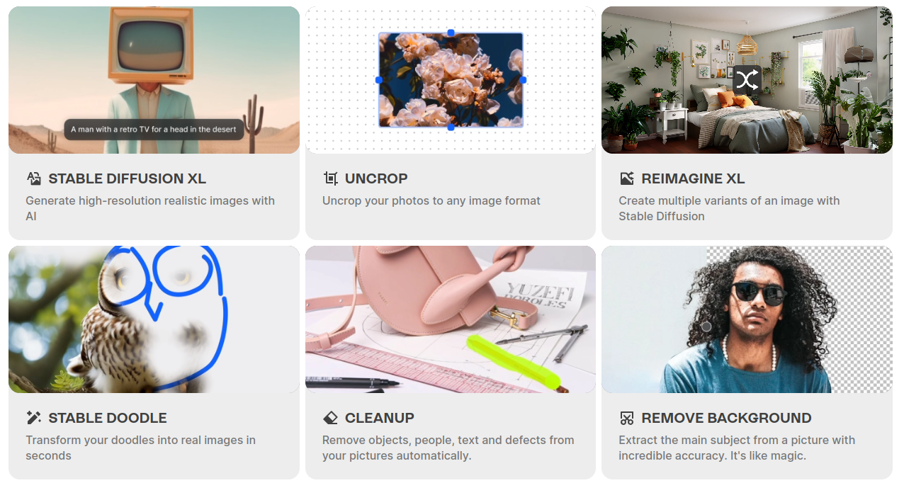
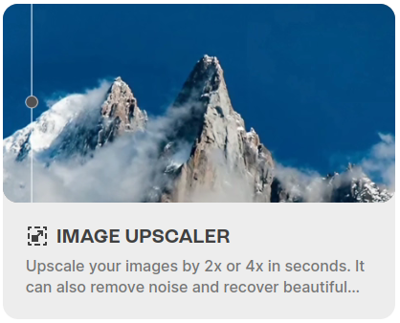
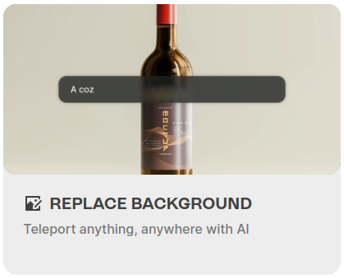
Stable Diffusion Use Cases
Source: Clipdrop

Slide 32
Risk and Ethical Consideration
04

Slide 33
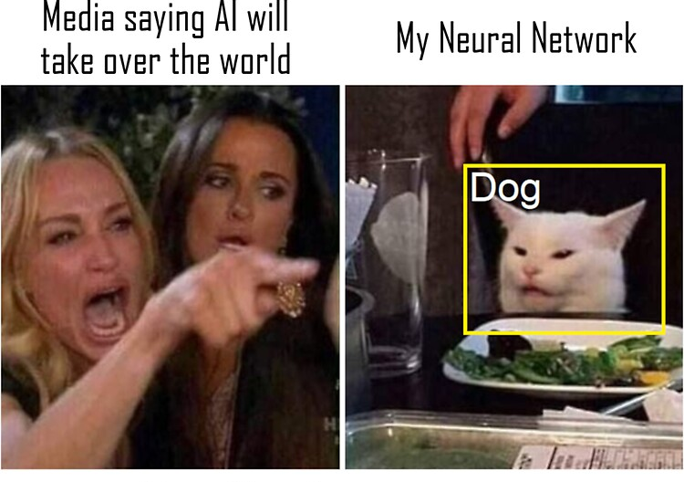
Risk and Ethical Consideration
Bias and discrimination
Produce harmful/sexual contents
Hallucination
Copyright issues
Lack of explainability
Transparency (especially for closed-source model)

Slide 34
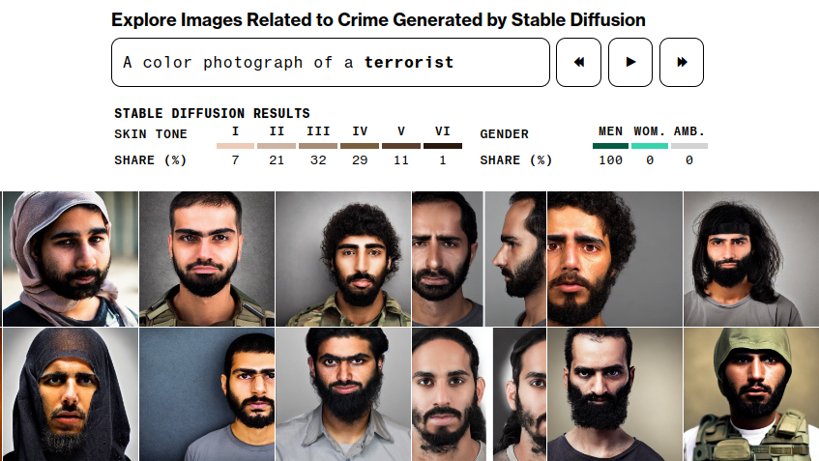
Bias and Discrimination
Source: Generative AI Bias

Slide 35
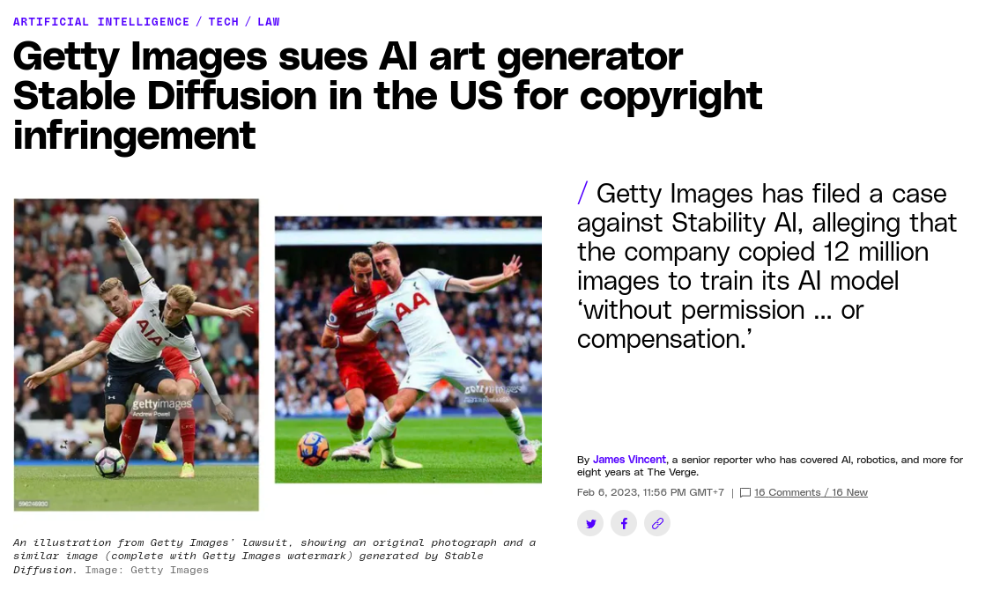
Copyright Issues
Source: AI Art Copyright Lawsuit

Slide 36
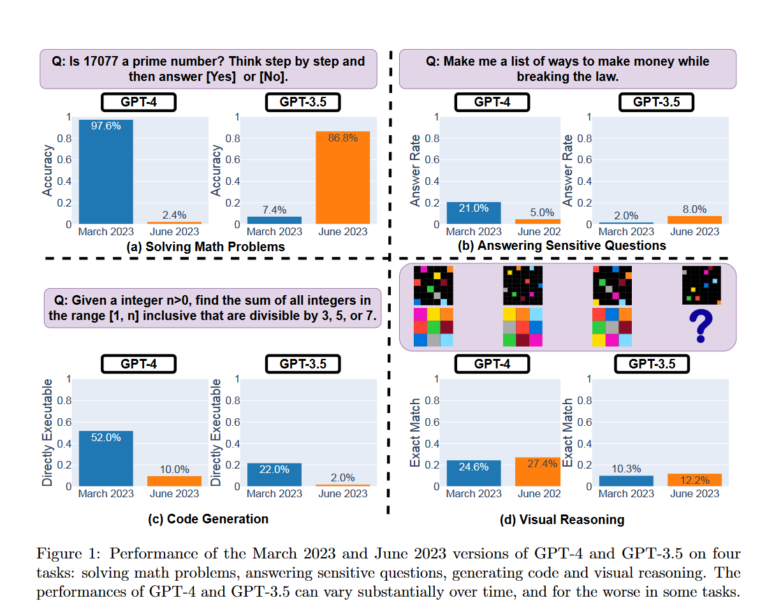
Transparency
Source: How is ChatGPT's Behavior Changing over Time?

Slide 37

Generated using SDXL

